Slide 1
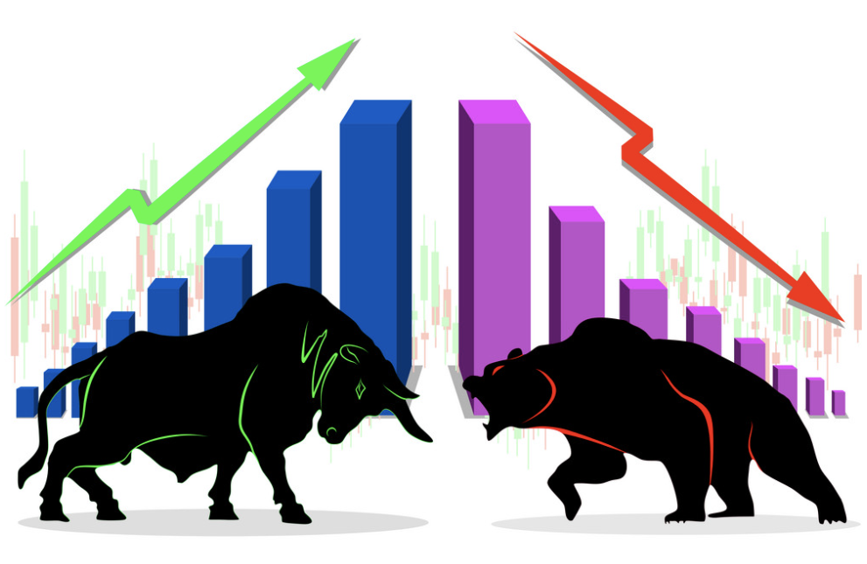
Sentiment Analysis and Abstractive Summarization for Stock Price Prediction
Team Members:
Anjan Shrestha
Aashish Pandey
Umesh Jaiswal
Puja Dhungana

Slide 2
Problem Statement
Stock market is volatile and predicting price is hard
Different factors influence the price
Social media is popular for expressing people’s sentiments on these factors
Negative (decrease) and positive(increase ) reviews largely affects stock price
Better prediction of stock price ensures safety of people’s investment and minimise risk

Slide 3
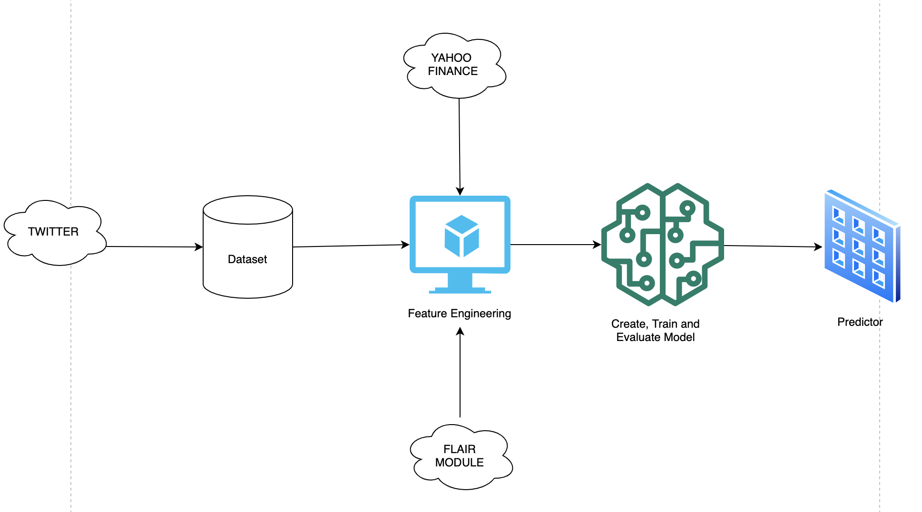
ML Structure / Workflow

Slide 4
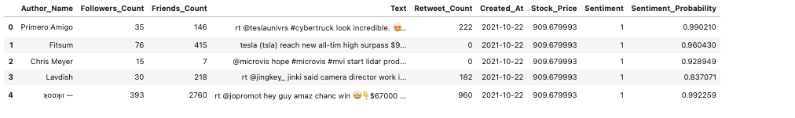
Dataset Used
Collected Raw sentiments from Twitter API
Extracted dataset in json file and stored in pandas dataframe
Extracted Stock price level using Yahoo Finance API
Stored data in pandas dataframe using yahoo finance module
Used six features for predicting next day stock price
For Machine Learning, divided data into 70% train and 30% test

Slide 5
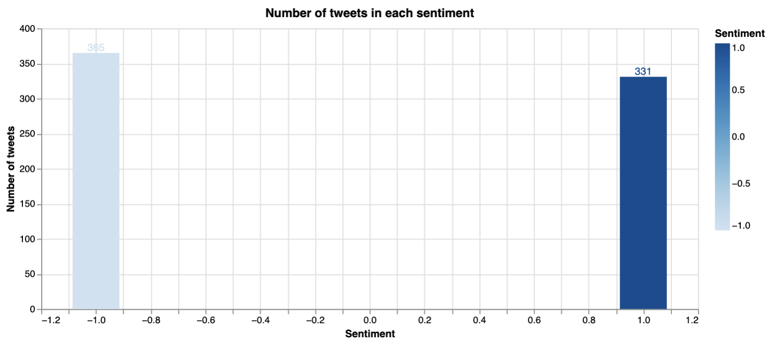
Exploratory Data Analysis
In the first 7 days of tweet, 385 was found to be negative and 331 was found to be positive sentiment tweet.

Slide 6
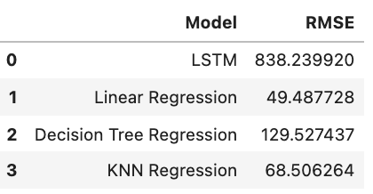
Machine Learning Models
Used different machine learning models such as LSTM, Linear Regression, Decision Tree Regression and KNN Regression
Compared their root mean square error and used the one with best score (i.e. Linear Regression)
Performed abstractive summarization using pre-trained model

Slide 7
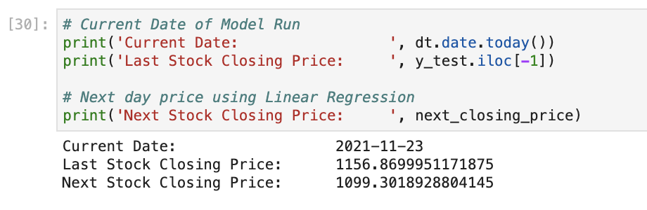
Predicting Stock Price
Ran linear regression model on 23rd November 2021
Last closing stock price was shown by our model to be $1156.86.
Next closing stock price was predicted by our model to be $1099.30.

Slide 8
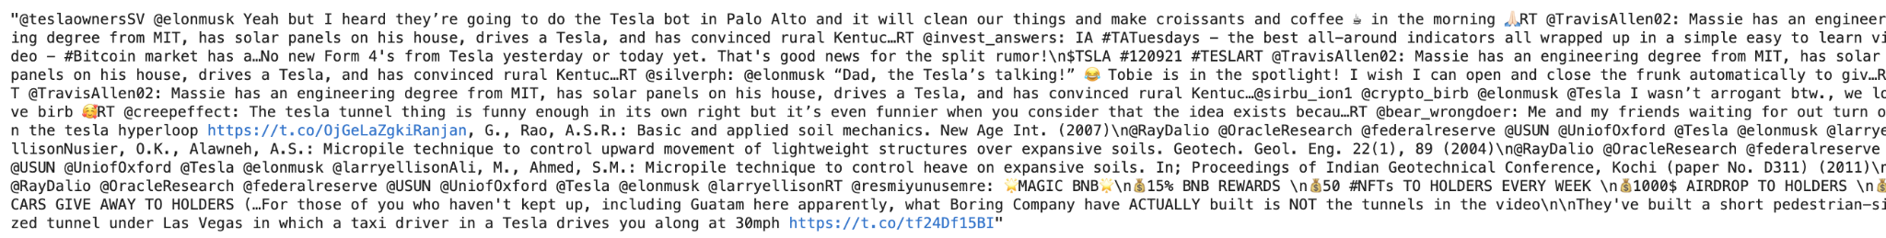
Performing Abstractive Summarization
Model took the last four/five tweets and produced the following paragraph.
Used the above paragraph as an input in our abstractive summarization model.
Used the above sentiment data in our model and got the following abstract summary.

Slide 9
Future Improvement
Add Fundamental and Technical features to the dataset
Try with other ML learning models
Hyperparameter tuning to fine tune the models even better
Extract data from other different sources such as Facebook and Discord

